Slide 1

Machine Vision CHC6781
Lecture 4:
Backpropagation and Neural Network
Module Leader: Dr Happy N. Monday
Contact via:
Email: happy.monday@zy.cdut.edu.cn
Office: Room 8102

Slide 2

Class Rules
Be on time
Bring your stuff (Pen, papers, folder, brain)
No pressing of phone, or gaming in the class.
Habit of Effective learners.
Prepare for your coursework and exam on time.
Always revise your PPTs before and after class.
Have Fun

Slide 3
Learning Outcomes
Understand how neural networks learn and adapt to data.
Students should be able to explain the role of backpropagation in neural network training and identify its significance.
Understand the insight computational graph provides into the internal mechanics of neural networks, facilitating the tracking of data flow and error propagation.
Comprehending the basics of neural network structures and their applications in various domains.

Slide 4
References
1. Richard Szeliski. (2017). Computer Vision: Algorithms and Applications. Springer
2. Géron, A. (2019). Hands-On Machine Learning with Scikit-Learn, Keras, and TensorFlow. O'Reilly Media.
3. Aggarwal, C.C. (2018). Neural Networks and Deep Learning. Springer
4. Goodfellow, I., Bengio, Y., & Courville, A. (2016). Deep Learning. MIT Press.
5. Hastie, T., Tibshirani, R., & Friedman, J. (2009). The Elements of Statistical Learning: Data Mining, Inference, and Prediction. Springer.
Gulli, A, Pal, S. (2017). Deep Learning with Keras. Packt Publishing
Montavon, G. Orr, G. Muller, K.K. (2012). Neural Networks: Tricks of the Trade. Springer.

Slide 5
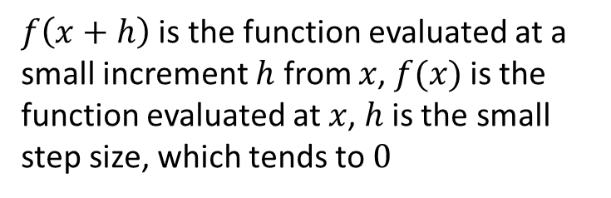
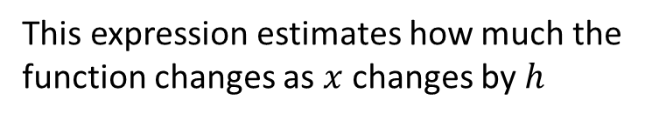
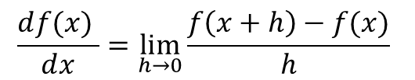
Recall from the last class: Gradient Descent
Numerical Gradient:
Slow
Approximate
Easy to write
Analytical Gradient
Fast
Exact
Error-prone
$$\frac{ⅆf(x) }{ⅆx}=\lim_{h→0}{\frac{f\left(x+h\right)−f(x)}{h}}$$
This expression estimates how much the function changes as $x$ changes by $h$
$f\left(x+h\right)$ is the function evaluated at a small increment $h$ from $x$, $f(x)$is the function evaluated at $x$, $h$ is the small step size, which tends to $0$

Slide 6
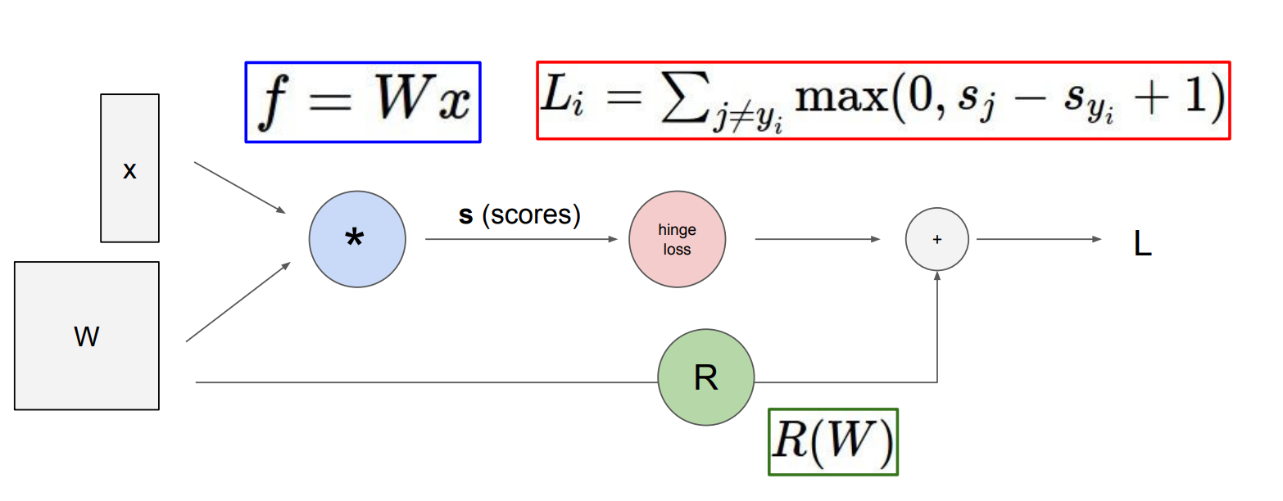
Computational graphs

Slide 7
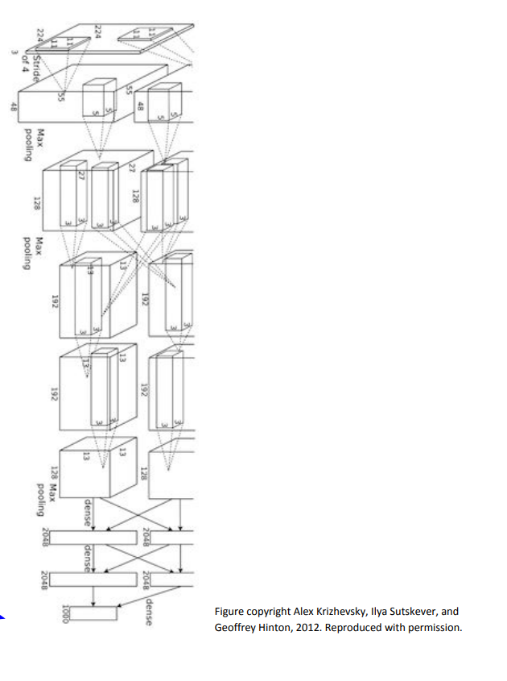
Convolutional Network
(AlexNet)
Input image
Weights
Loss

Slide 8
Backpropagation
Backpropagation is a fundamental algorithm used in Artificial Neural Networks (ANN) to adjust the weights of the network based on the error in the prediction. It involves two phases: forward propagation and backward propagation.
The goal of backpropagation is to minimize the difference between the network's output and the actual target output by updating the weights in the network using gradient descent.

Slide 9
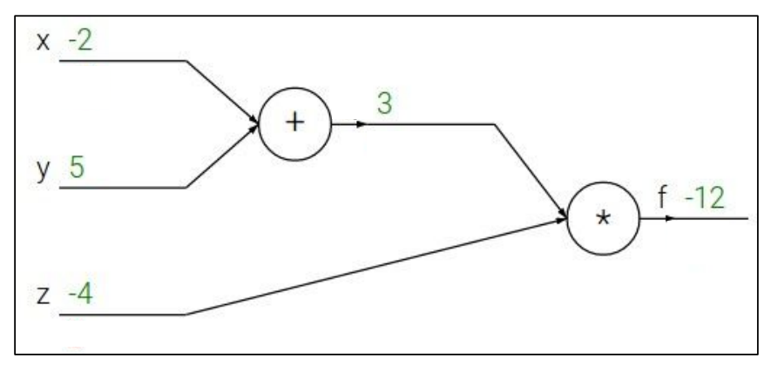
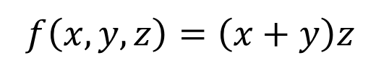
Backpropagation: a simple example
$$f\left(x,y,z\right)=\left(x+y\right)z$$
e.g.
X = -2, y = 5, z = -4

Slide 10
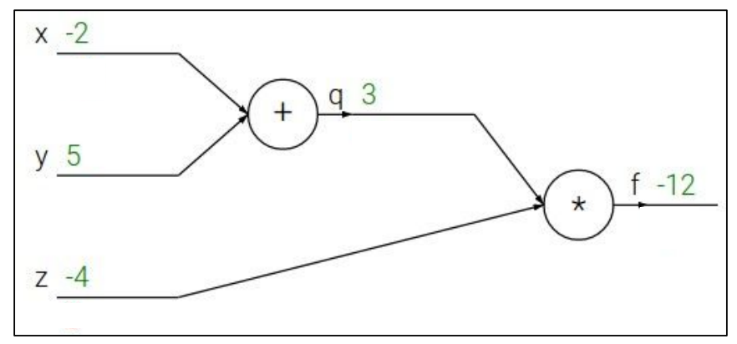
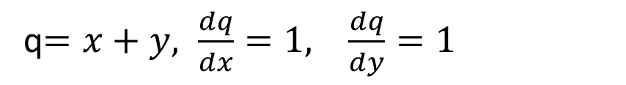
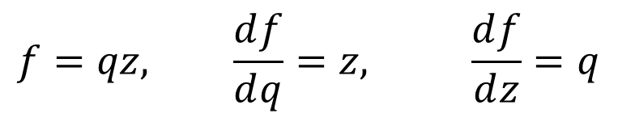
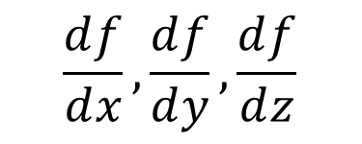
Backpropagation: a simple example
$$f\left(x,y,z\right)=\left(x+y\right)z$$
e.g.
X = -2, y = 5, z = -4
q$=x+y, \frac{ⅆq}{ⅆx}=1, \frac{ⅆq}{ⅆy}=1$
$$f=qz, \frac{ⅆf}{ⅆq}=z, \frac{ⅆf}{ⅆz}=q$$
Want:
$$\frac{ⅆf}{ⅆx}, \frac{ⅆf}{ⅆy},\frac{ⅆf}{ⅆz}$$

Slide 11
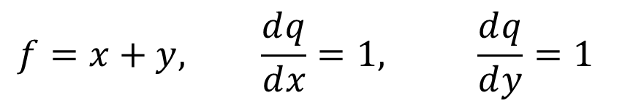

Backpropagation: a simple example
$$f\left(x,y,z\right)=\left(x+y\right)z$$
e.g.
X = -2, y = 5, z = -4
$$f=x+y, \frac{ⅆq}{ⅆx}=1, \frac{ⅆq}{ⅆy}=1$$
$$\frac{ⅆf}{ⅆf}$$
$$f=qz, \frac{ⅆf}{ⅆq}=z, \frac{ⅆf}{ⅆz}=q$$
Want:
$$\frac{ⅆf}{ⅆx}, \frac{ⅆf}{ⅆy},\frac{ⅆf}{ⅆz}$$

Slide 12


Backpropagation: a simple example
$$f\left(x,y,z\right)=\left(x+y\right)z$$
e.g.
X = -2, y = 5, z = -4
$$1$$
$$f=x+y, \frac{ⅆq}{ⅆx}=1, \frac{ⅆq}{ⅆy}=1$$
$$\frac{ⅆf}{ⅆf}$$
$$f=qz, \frac{ⅆf}{ⅆq}=z, \frac{ⅆf}{ⅆz}=q$$
Want:
$$\frac{ⅆf}{ⅆx}, \frac{ⅆf}{ⅆy},\frac{ⅆf}{ⅆz}$$

Slide 13

Backpropagation: a simple example
$$f\left(x,y,z\right)=\left(x+y\right)z$$
e.g.
X = -2, y = 5, z = -4
$$1$$
$$f=x+y, \frac{ⅆq}{ⅆx}=1, \frac{ⅆq}{ⅆy}=1$$
$$\frac{ⅆf}{ⅆz}$$
$$f=qz, \frac{ⅆf}{ⅆq}=z, \frac{ⅆf}{ⅆz}=q$$
Want:
$$\frac{ⅆf}{ⅆx}, \frac{ⅆf}{ⅆy},\frac{ⅆf}{ⅆz}$$

Slide 14

Backpropagation: a simple example
$$f\left(x,y,z\right)=\left(x+y\right)z$$
e.g.
X = -2, y = 5, z = -4
$$1$$
$$3$$
$$f=x+y, \frac{ⅆq}{ⅆx}=1, \frac{ⅆq}{ⅆy}=1$$
$$\frac{ⅆf}{ⅆz}$$
$$f=qz, \frac{ⅆf}{ⅆq}=z, \frac{ⅆf}{ⅆz}=q$$
Want:
$$\frac{ⅆf}{ⅆx}, \frac{ⅆf}{ⅆy},\frac{ⅆf}{ⅆz}$$

Slide 15

Backpropagation: a simple example
$$f\left(x,y,z\right)=\left(x+y\right)z$$
e.g.
X = -2, y = 5, z = -4
$$1$$
$$3$$
$$f=x+y, \frac{ⅆq}{ⅆx}=1, \frac{ⅆq}{ⅆy}=1$$
$$\frac{ⅆf}{ⅆq}$$
$$f=qz, \frac{ⅆf}{ⅆq}=z, \frac{ⅆf}{ⅆz}=q$$
Want:
$$\frac{ⅆf}{ⅆx}, \frac{ⅆf}{ⅆy},\frac{ⅆf}{ⅆz}$$

Slide 16

Backpropagation: a simple example
$$f\left(x,y,z\right)=\left(x+y\right)z$$
$$−4$$
e.g.
X = -2, y = 5, z = -4
$$1$$
$$3$$
$$f=x+y, \frac{ⅆq}{ⅆx}=1, \frac{ⅆq}{ⅆy}=1$$
$$\frac{ⅆf}{ⅆq}$$
$$f=qz, \frac{ⅆf}{ⅆq}=z, \frac{ⅆf}{ⅆz}=q$$
Want:
$$\frac{ⅆf}{ⅆx}, \frac{ⅆf}{ⅆy},\frac{ⅆf}{ⅆz}$$

Slide 17

Backpropagation: a simple example
$$f\left(x,y,z\right)=\left(x+y\right)z$$
$$−4$$
e.g.
X = -2, y = 5, z = -4
$$1$$
$$3$$
$$f=x+y, \frac{ⅆq}{ⅆx}=1, \frac{ⅆq}{ⅆy}=1$$
$$\frac{ⅆf}{ⅆy}$$
$$f=qz, \frac{ⅆf}{ⅆq}=z, \frac{ⅆf}{ⅆz}=q$$
Want:
$$\frac{ⅆf}{ⅆx}, \frac{ⅆf}{ⅆy},\frac{ⅆf}{ⅆz}$$

Slide 18
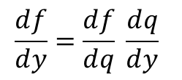

Backpropagation: a simple example
$$f\left(x,y,z\right)=\left(x+y\right)z$$
$$−4$$
e.g.
X = -2, y = 5, z = -4
$$−4$$
$$1$$
$$3$$
$$f=x+y, \frac{ⅆq}{ⅆx}=1, \frac{ⅆq}{ⅆy}=1$$
$$\frac{ⅆf}{ⅆy}$$
c
$$f=qz, \frac{ⅆf}{ⅆq}=z, \frac{ⅆf}{ⅆz}=q$$
Chain Rule:
$$\frac{ⅆf}{ⅆy}=\frac{ⅆf}{ⅆq} \frac{ⅆq}{ⅆy}$$
Want:
$$\frac{ⅆf}{ⅆx}, \frac{ⅆf}{ⅆy},\frac{ⅆf}{ⅆz}$$

Slide 19

Backpropagation: a simple example
$$f\left(x,y,z\right)=\left(x+y\right)z$$
$$−4$$
e.g.
X = -2, y = 5, z = -4
$$−4$$
$$1$$
$$3$$
$$f=x+y, \frac{ⅆq}{ⅆx}=1, \frac{ⅆq}{ⅆy}=1$$
$$\frac{ⅆf}{ⅆx}$$
c
$$f=qz, \frac{ⅆf}{ⅆq}=z, \frac{ⅆf}{ⅆz}=q$$
Want:
$$\frac{ⅆf}{ⅆx}, \frac{ⅆf}{ⅆy},\frac{ⅆf}{ⅆz}$$

Slide 20

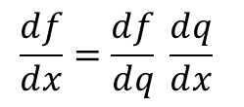
Backpropagation: a simple example
$$−4$$
$$f\left(x,y,z\right)=\left(x+y\right)z$$
$$−4$$
e.g.
X = -2, y = 5, z = -4
$$−4$$
$$1$$
$$3$$
$$f=x+y, \frac{ⅆq}{ⅆx}=1, \frac{ⅆq}{ⅆy}=1$$
$$\frac{ⅆf}{ⅆx}$$
c
$$f=qz, \frac{ⅆf}{ⅆq}=z, \frac{ⅆf}{ⅆz}=q$$
Chain Rule:
$$\frac{ⅆf}{ⅆx}=\frac{ⅆf}{ⅆq} \frac{ⅆq}{ⅆx}$$
Want:
$$\frac{ⅆf}{ⅆx}, \frac{ⅆf}{ⅆy},\frac{ⅆf}{ⅆz}$$

Slide 21
Next: Neural Networks

Slide 22
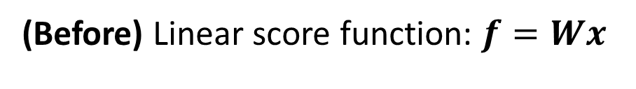
Neural Networks: without the brain stuffs
(Before) Linear score function: $f=Wx$

Slide 23
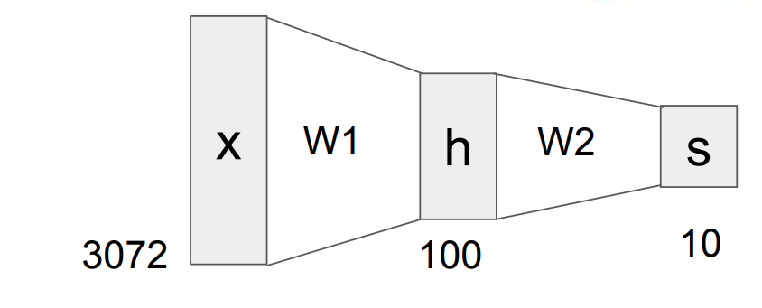
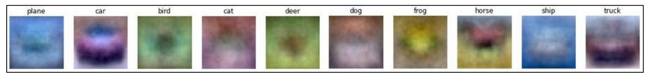
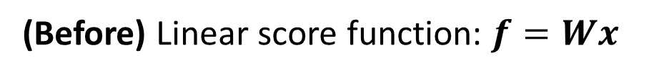
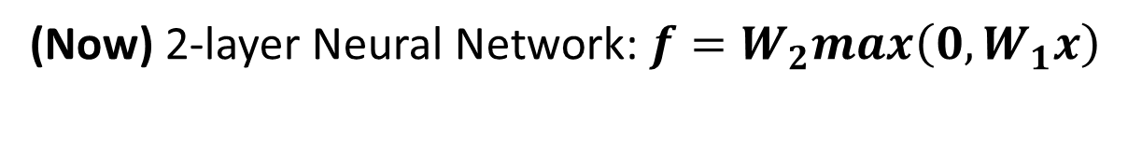
Neural Networks: without the brain stuffs
(Before) Linear score function: $f=Wx$
(Now) 2-layer Neural Network: $f=W_{2}max\left(0,W_{1}x\right)$

Slide 24
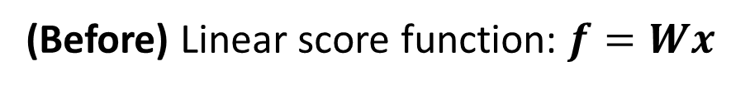
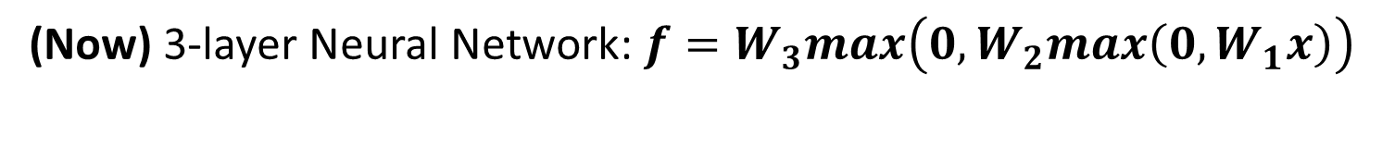
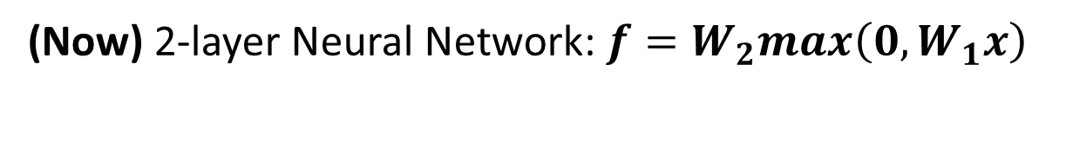
Neural Networks: without the brain stuffs
(Before) Linear score function: $f=Wx$
(Now) 2-layer Neural Network: $f=W_{2}max\left(0,W_{1}x\right)$
(Now) 3-layer Neural Network: $f=W_{3}max\left(0,W_{2}max\left(0,W_{1}x\right)\right)$

Slide 25
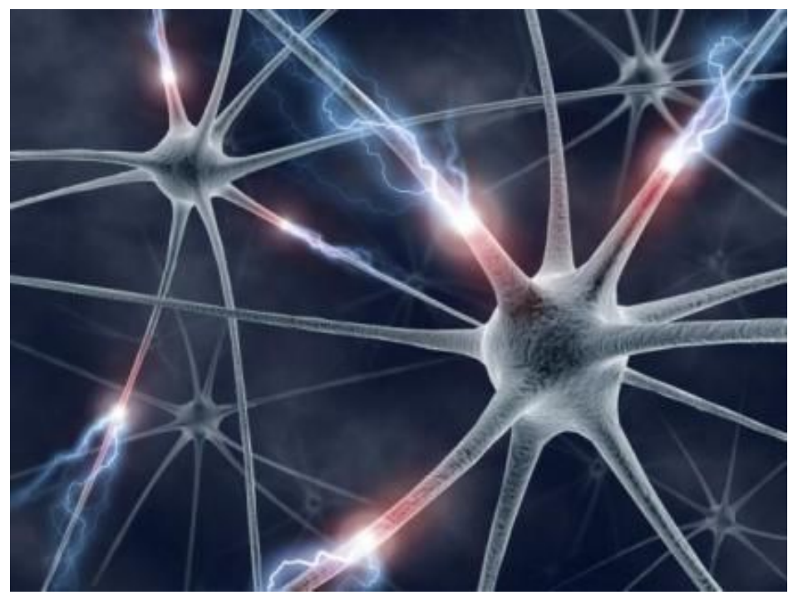
Neural Networks: with the brain stuffs

Slide 26
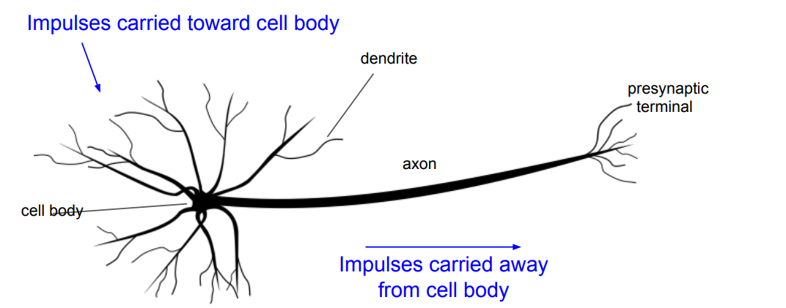
Neural Networks: with the brain stuffs

Slide 27
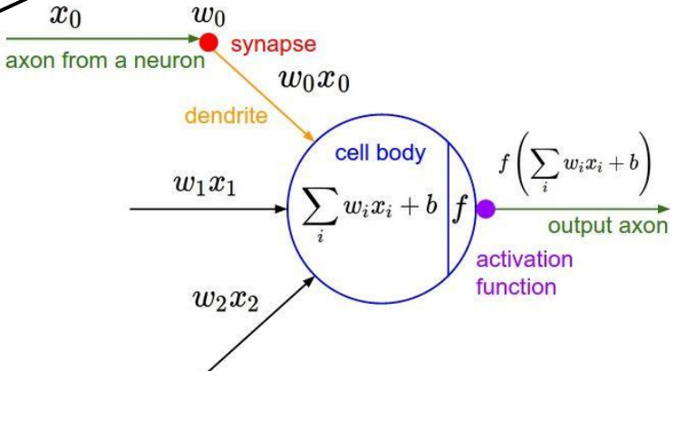
Neural Networks: with the brain stuffs

Slide 28
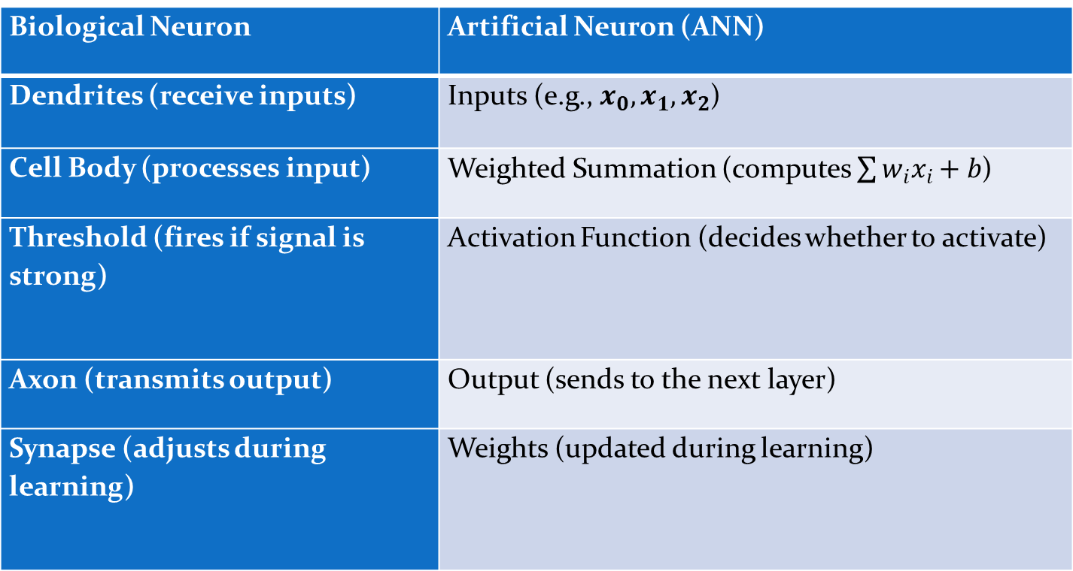
Neural Networks: with the brain stuffs
Biological Neuron | Artificial Neuron (ANN)
Dendrites (receive inputs) | Inputs (e.g., $x_{0},x_{1},x_{2}$)
Cell Body (processes input) | Weighted Summation (computes $\sum{w_{i}x_{i}+b}$)
Threshold (fires if signal is strong) | Activation Function (decides whether to activate)
Axon (transmits output) | Output (sends to the next layer)
Synapse (adjusts during learning) | Weights (updated during learning)

Slide 29
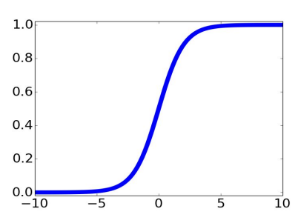
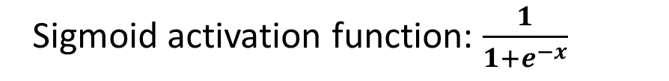
Neural Networks: with the brain stuffs
Sigmoid activation function: $\frac{1}{1+e^{−x}}$

Slide 30
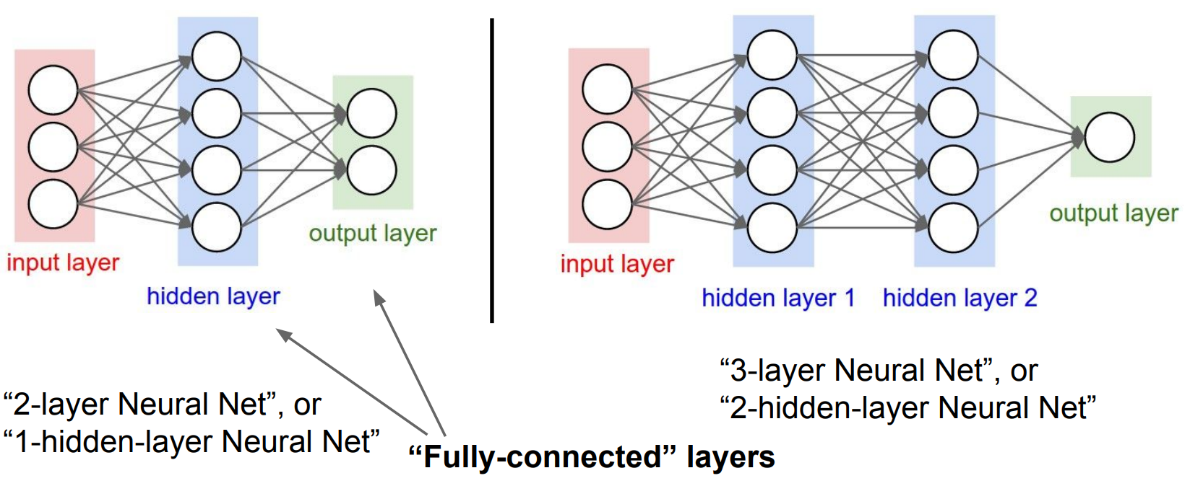
Neural Networks: Architectures

Slide 31
Summary
We arrange neural into fully-connected layers
The abstraction of a layer has the nice property that it allows us to use efficient vectorized code.

Slide 32
The End!

